Slide 1

C++ Collections
C++ Templates
Vectors and Lists
Object Slicing
Polymorphism

Slide 2

See Also
http://www.cplusplus.com/reference/stl/
https://www.geeksforgeeks.org/generics-in-c/
Notes:
Here is some additional reading for you on the web.

Slide 3
Things
class ThingInt {
public:
int thing;
void set(int value) {
thing = value;
}
int get() {
return thing;
}
int sum(int other) {
return thing + other;
}
};
C++
C++
class ThingStr {
public:
string thing;
void set(string value) {
thing = value;
}
string get() {
return thing;
}
string sum(string other) {
return thing + other;
}
};
class ThingFloat {
public:
float thing;
void set(float value) {
thing = value;
}
float get() {
return thing;
}
float sum(float other) {
return thing + other;
}
};
C++
Notes:
Silly example
Depends on the type having a “+” operator.
Value is copied in on the set. For built ins like int and float, that’s OK. What about for complex objects?

Slide 4



Using Things
ThingInt i;
i.set(15);
cout << i.sum(20) << endl;
ThingFloat f;
f.set(3.5);
cout << f.sum(1.2) << endl;
ThingStr s;
s.set("Hello");
cout << s.sum("World") << endl;
C++
35
4.7
HelloWorld
Notes:
The code is similar. And when I say similar I mean EXACTLY THE SAME, except for the type. We can think of the code generically – without a specific type – with a substitutable type. C++ templates:

Slide 5
C++ Templates
template<class T> class Thing {
public:
T thing;
void set(T value) {
thing = value;
}
T get() {
return thing;
}
T sum(T other) {
return thing + other;
}
};
C++
Thing<int> ti;
ti.set(15);
cout << ti.sum(20) << endl;
Thing<float> tf;
tf.set(3.5);
cout << tf.sum(1.2) << endl;
Thing<string> ts;
ts.set("Hello");
cout << ts.sum("World") << endl;
C++
35
4.7
HelloWorld
Notes:
#10 what happens if T doesn’t support “+”? Get a compile error when you try to use it with that type.

Slide 6
Vector of Things
#include <iostream>
#include <vector>
using namespace std;
class ThingInt {
public:
int thing;
};
C++
int main(int argc, char ** argv) {
vector<ThingInt> nums;
ThingInt i;
i.thing = 42;
nums.push_back(i);
i.thing = 50;
cout << nums[0].thing << endl;
cout << i.thing << endl;
}
C++
42
50

Slide 7
Vector of Things (Templates)
int main(int argc, char ** argv) {
vector<Thing<int> > nums;
Thing<int> i;
i.thing = 42;
nums.push_back(i);
i.thing = 50;
cout << nums[0].thing << endl;
cout << i.thing << endl;
}
C++
42
50

Slide 8
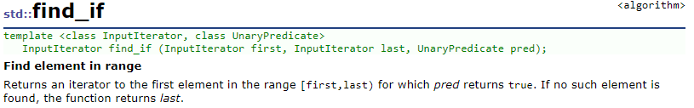
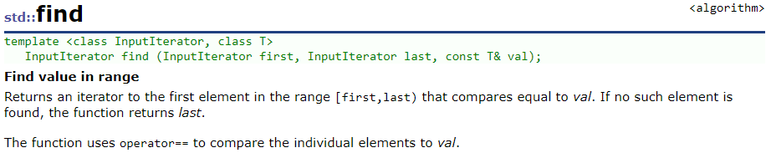
C++ <vector> and <list>
vector
list
insert()
erase()
clear()
operator[ ]
size() : int
empty()
push_back()
pop_back()
shrink_to_fit()
insert()
erase()
clear()
operator[ ]
size() : int
empty()
push_back()
push_front()
pop_back()
pop_front()
splice()
merge()

Slide 9
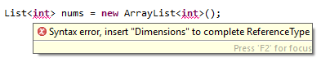
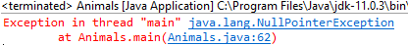
Collection of Built-ins
You can make containers of built-ins or classes.
C++ treats your classes like built-in types.
Not so in Java.
You can use the boxing classes we talked about earlier.
Java
Java
List<Integer> nums = new ArrayList<Integer>();
nums.add(0);
int a = nums.get(0);
nums.add(null);
int b = nums.get(1);

Slide 10

Object Slicing
class Animal {
public:
virtual void sayHi() {
cout << "Should not be here" << endl;
}
};
class Cat: public Animal {
public:
virtual void sayHi() {
cout << "Meow!" << endl;
}
};
class Dog: public Animal {
public:
virtual void sayHi() {
cout << "Woof!" << endl;
}
};
C++
void speak(Animal an) {
an.sayHi();
}
int main(int argc, char **argv) {
Dog dog;
dog.sayHi();
speak(dog);
}
C++
Woof!
Should not be here

Slide 11

Polymorphic Collections
Dog dog;
Cat cat;
dog.sayHi();
vector<Animal> zoo;
zoo.push_back(dog);
zoo.push_back(cat);
zoo[0].sayHi();
C++
Woof!
Should not be here

Slide 12

Polymorphic Collections
Dog * dog = new Dog();
Cat * cat = new Cat();
dog->sayHi();
vector<Animal*> zoo;
zoo.push_back(dog);
zoo.push_back(cat);
zoo[0]->sayHi();
zoo.erase(zoo.begin() + 1);
zoo.erase(zoo.begin());
delete dog;
delete cat;
C++
Woof!
Woof!
Notes:
Still need a virtual destructor in my class with virtual functions. Didn’t technically have to erase or even delete.

Slide 13

Tinkering
Make a class that holds a fixed size array of 5000 integers.
Perform a timing analysis of inserting 1000 objects to the start of a <vector>. Then to a <list>.
Perform a timing analysis of reading 1000 random elements from a <vector> and a <list>.
Do the times make sense to you knowing how these collections are implemented?
Notes:
Here are a couple of things to think about and/or try. This is totally optional … nothing for you to send to me.

